Slide 1
Isuzu VN74 Module Pin-out Information
IMSA
Aug 3, 2010

Slide 2
Summary of pins of interest for Burke E. Porter bench test set-up
 | GMLAN |  | J1850 | J1939 |  | GND | V_Batt | Ignition Switch Input
 | Hi | Lo |  | Hi | Lo |  |  | ACC / Run | Run / Crank
PIM | B1, B3 | B2, B4 | N/A | A16 | A18 | B21 | B22 | B24 | B23
ECM | J1-28 | J1-27 | N/A | N/A | N/A | J1-73 | J1-20 | J1-18 | J1-19
TCM* | 10, 14 | 11, 13 | N/A | N/A | N/A | 5 | 4 | 9 | 12
ABS | N/A | N/A | 29 | 26 | 27 | 1, 23 | 2, 24 | - | 3
* TCM connector info is for the pass-thru connector on the outside of the transmission

Slide 3
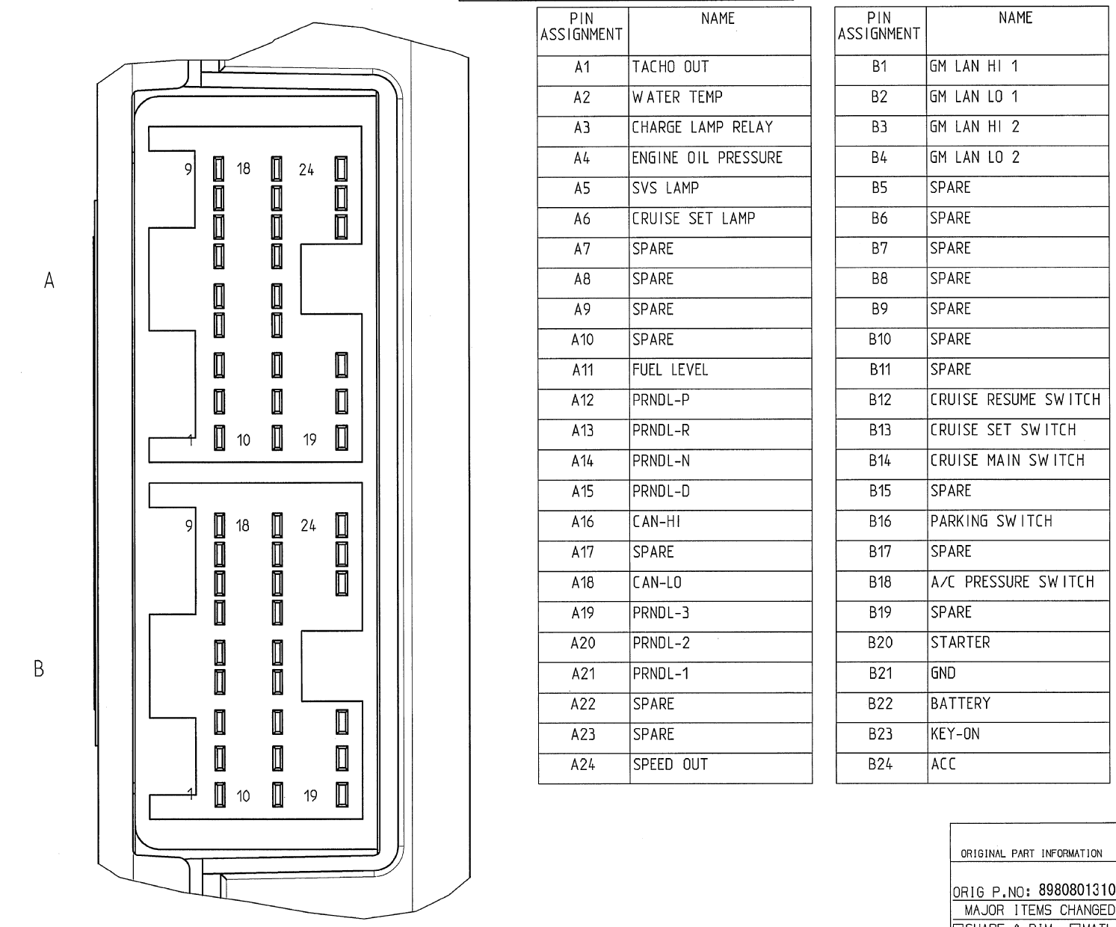
PIM Pin-out

Slide 4
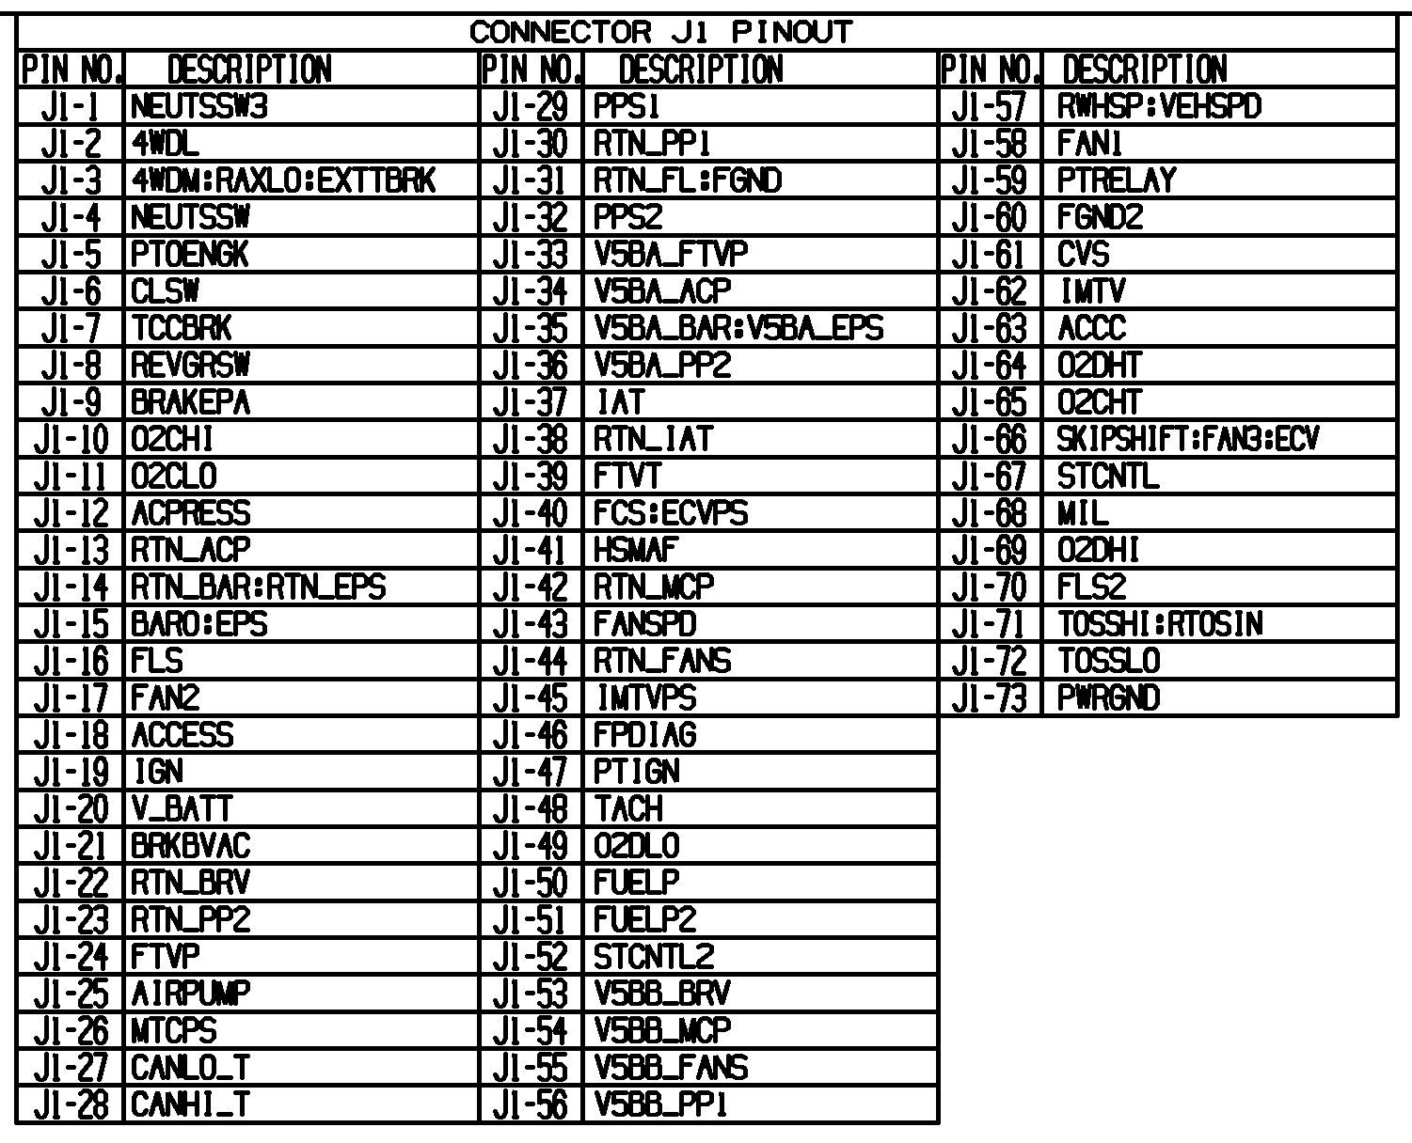
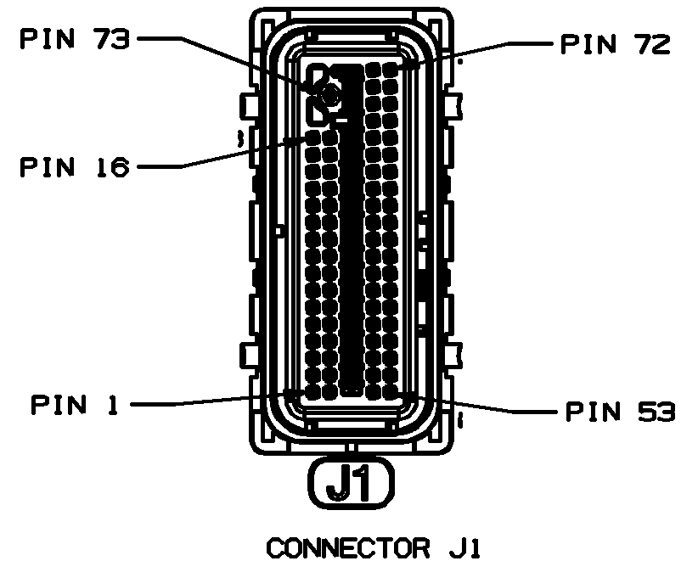
ECM Pin-out

Slide 5
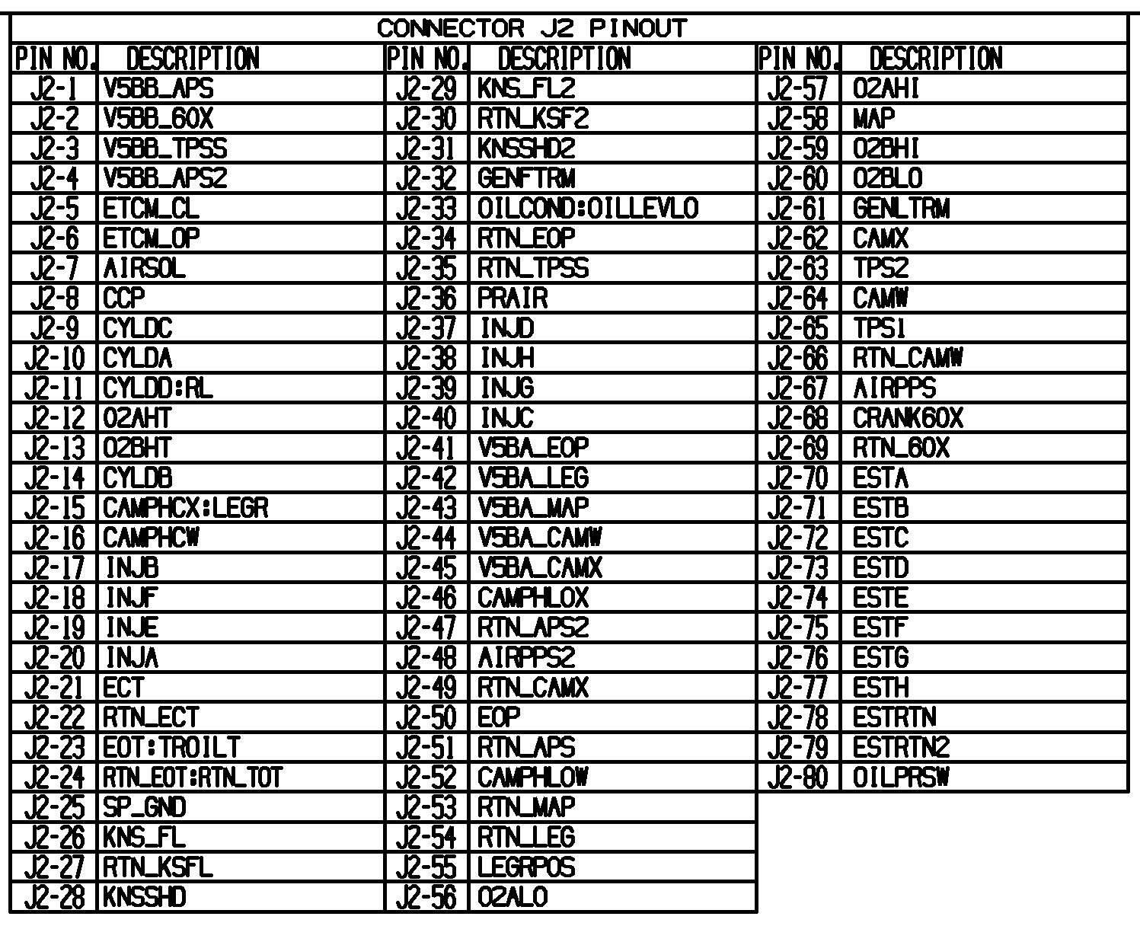
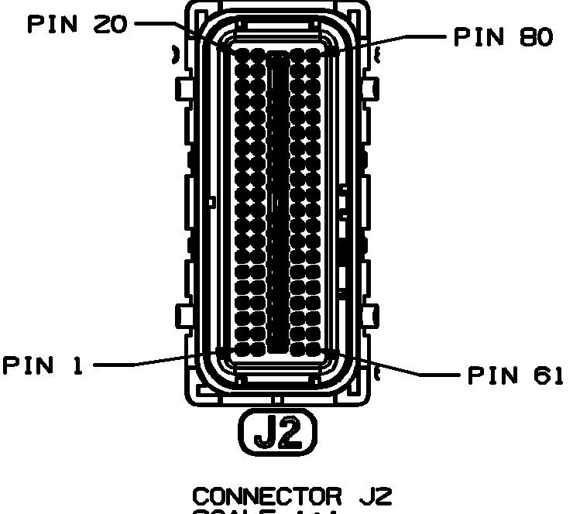
ECM Pin-out

Slide 6
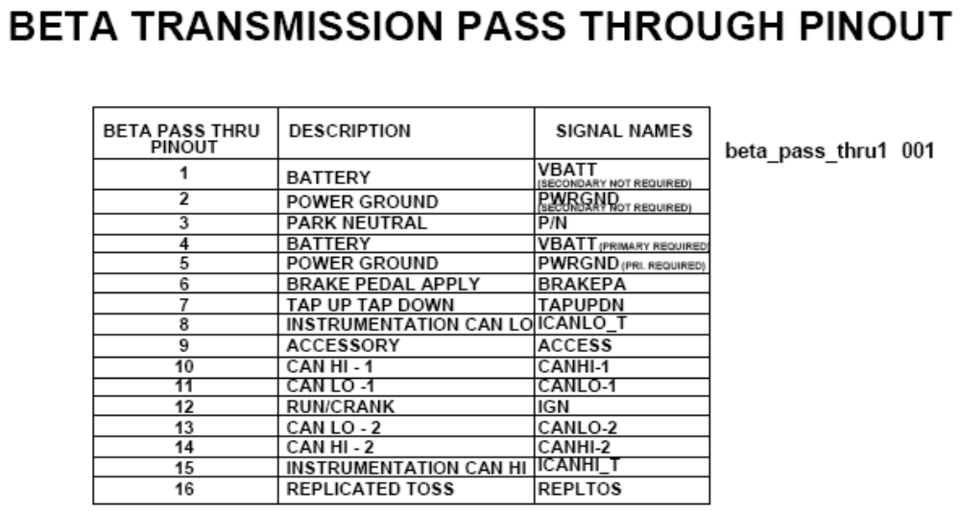
TCM Pin-out
(This pin-out is for the connector on the outside of the transmission, because the TCM is internal to the Transmission Isuzu does not know the pin-out of the T43 TCM itself)

Slide 7
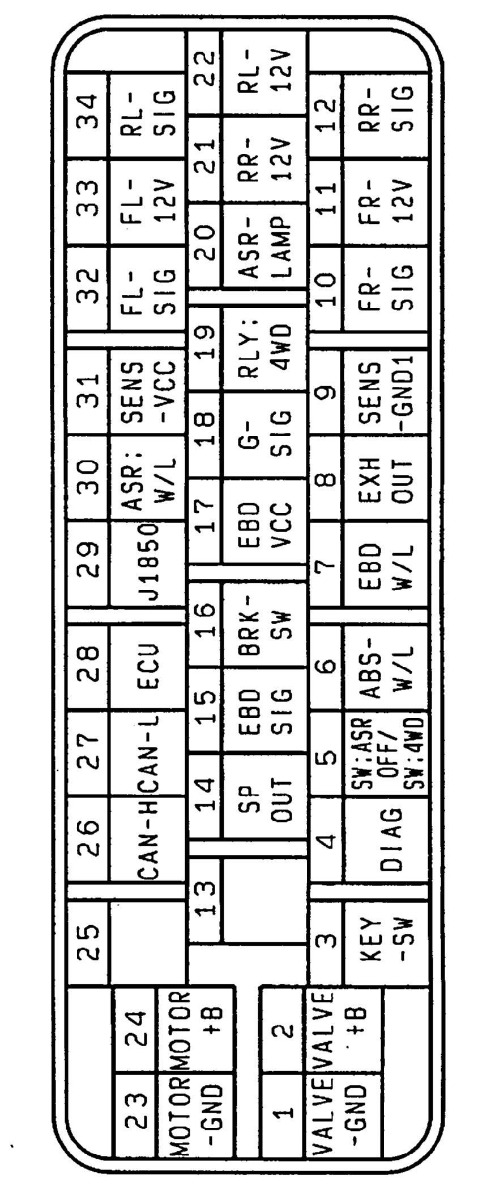
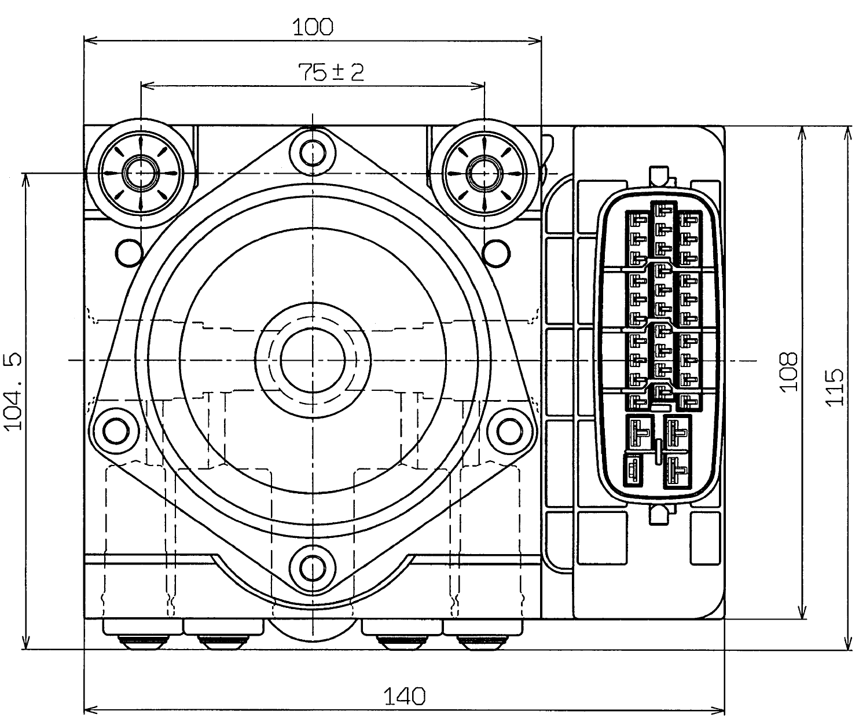
ABS HU Pin-out

